Slide 1
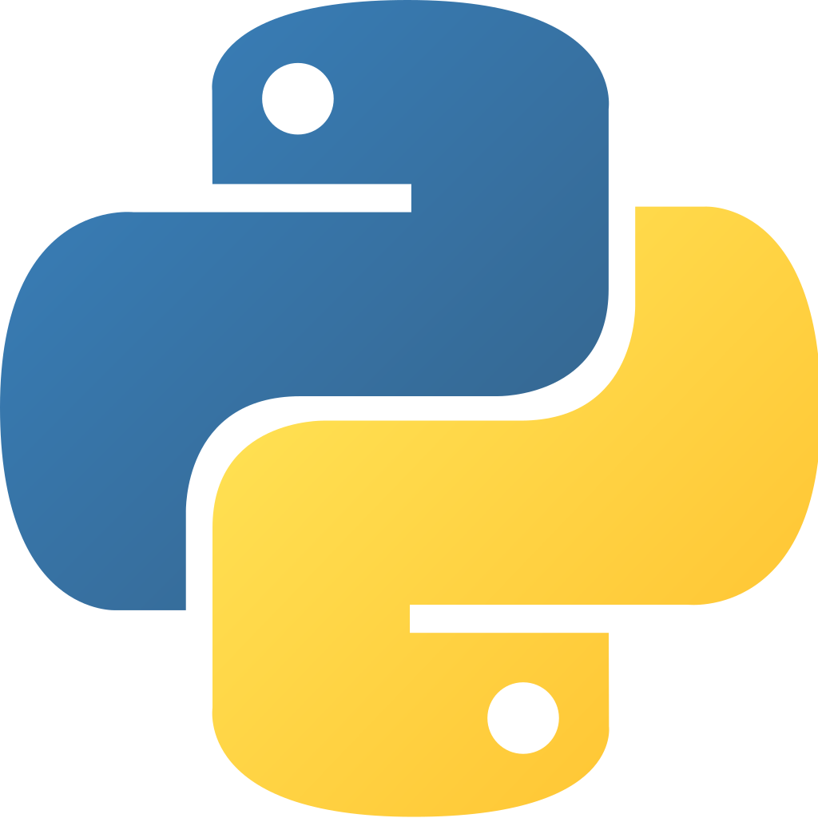
Python for Data Analysis
INNOMATICS RESEARCH LABS

Slide 2

About me
Background ? (B-tech or M-tech)
Why you want to learn Data Science
Any work experience
What like you about Innomatics Research lab
YOUR NAME

Slide 3
Agenda
History of Python
Why Python and its Applications
How Python is useful Data Science
Data Science Life Cycle
Business Problem
Scrape Data from internet using Python

Slide 4
HISTORY OF PYTHON
Python developed by Guido van Rossum in late 1980
Write some thing about python like
Why it is called general purpose language
Libraries in python
Application where python is used
Why python is used in Data Science
Add more like above

Slide 5
Add Slides

Slide 6
THANK YOU!

